Slide 1


GPU Programming (in CUDA)
Spring 2019
Julian Gutierrez
Session 13

Slide 2
Outline
Last Class
Summary of what we did
What to do next?
A little on OpenACC
New features
Final Project

Slide 3
“On a GPU to get 10x speedup is easy, to get 50x is hard.”
Perhaad Mistry, PhD

Slide 4
Last class!
Thank you everyone for attending!

Slide 5
Summary of what we learned
Why parallelism is important (Session 01)
How to use the server (Session 02)
How GPUs execution model work (Session 03)
Writing our first GPU code (Session 04 – lab)
How the GPU memory system works (Session 05)
How to use global memory efficiently (Session 06 – lab)
How to use shared memory efficiently (Session 07 – lab)
Efficient parallel implementation of popular algorithms (Session 08)
Very basic outline of image processing (Session 09)
Different image processing algorithm GPU implementations (Session 10 - lab)
Advanced techniques to reduce execution time (pinned memory and streams), reduce complexity for programmer with unified memory and dynamic parallelism (Session 11)
Using these techniques to show how they help (Session 12 – lab)

Slide 6
Survey
Please fill out this anonymous survey:
https://goo.gl/forms/EvccPLoJdvxFiIiY2
… and be constructive ☺

Slide 7
What to do next?
Now that you know the basics
you can learn more advanced features/new features.
you can apply what you learn to research projects.
you can build upon this knowledge to do better in school ☺
Let’s go over some of these features

Slide 8
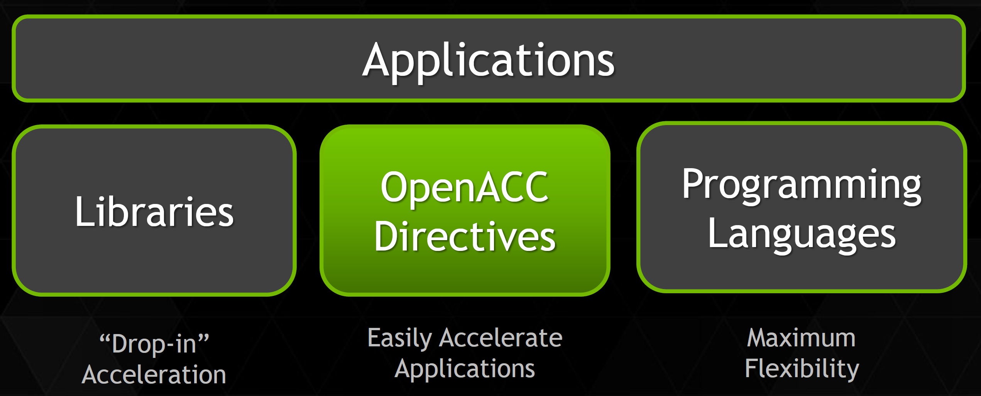
OpenACC
3 ways to accelerate applications

Slide 9
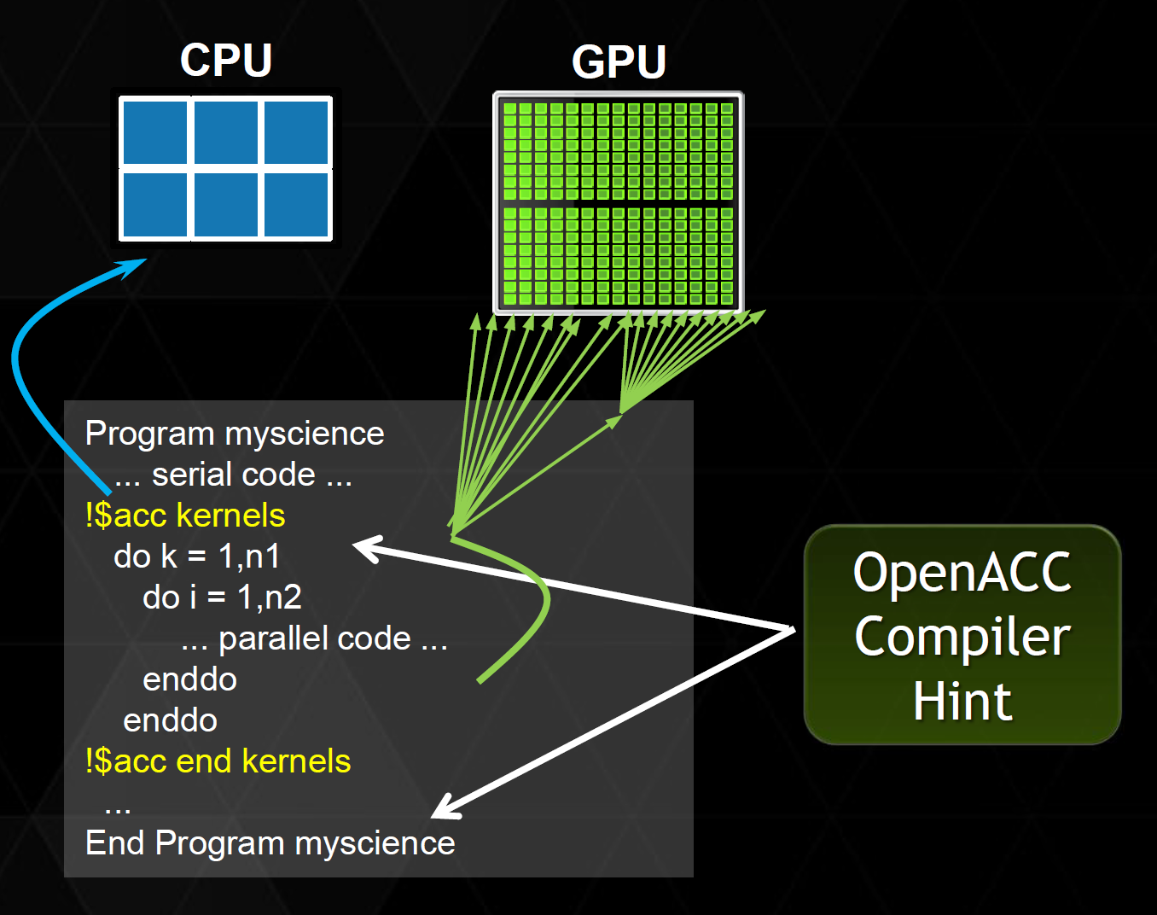
OpenACC
Directives
Simple Compiler hints
Compiler parallelizes code
Works on many-core GPUs and multicore CPUs

Slide 10
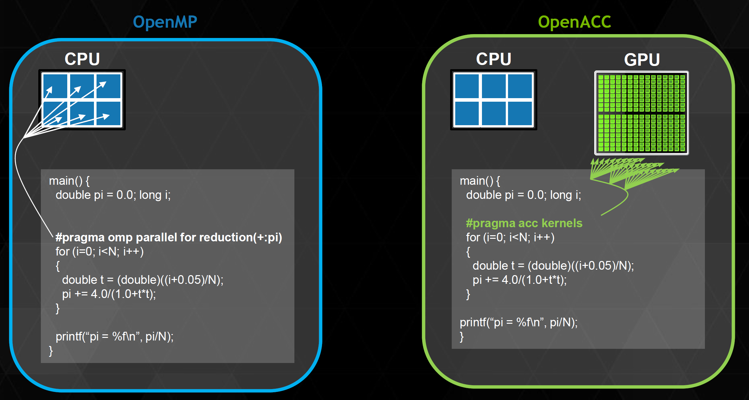
OpenACC
Its very similar to programming in OpenMP

Slide 11
OpenACC
According to NVIDIA
Obtained 5x in 40 hours for real-time object detection system.
Obtained 2x in 4 hours for valuation of stock portfolios using Monte Carlo.
Obtained 5x in 8 hours for interaction of solvents and biomolecules.
“Optimizing code with directives is quite easy, especially compared to CPU threads or writing CUDA kernels. The most important thing is avoiding restructuring of existing code for production applications”

Slide 12
OpenACC
With directives, tuning work focuses on exposing parallelism, which makes codes inherently better

Slide 13
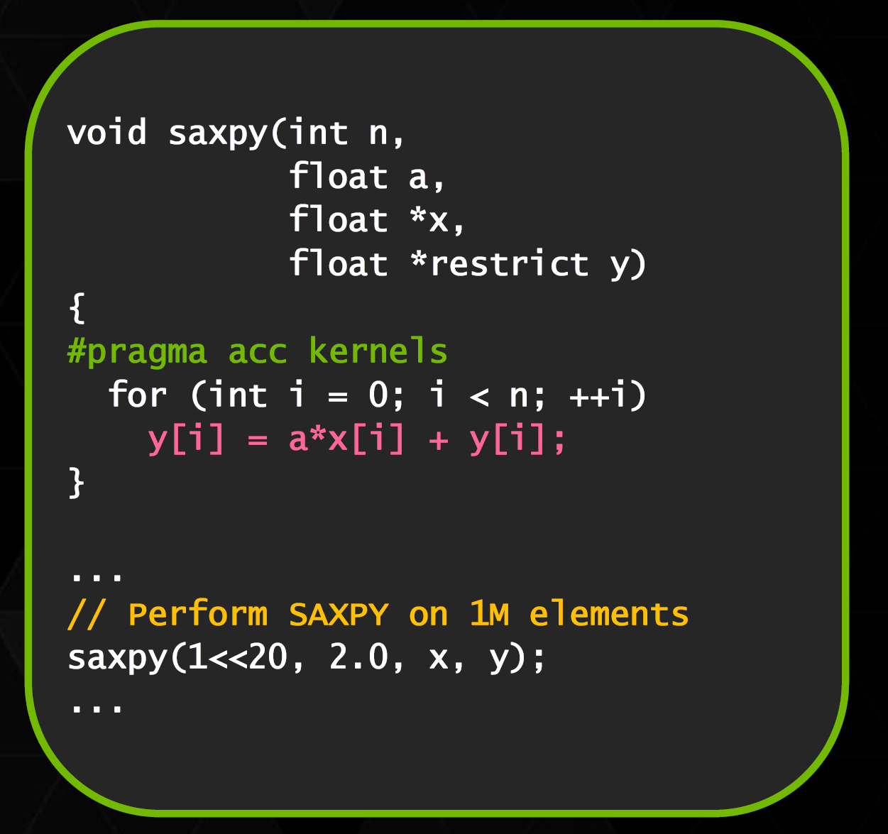
OpenACC
Example: SAXPY

Slide 14
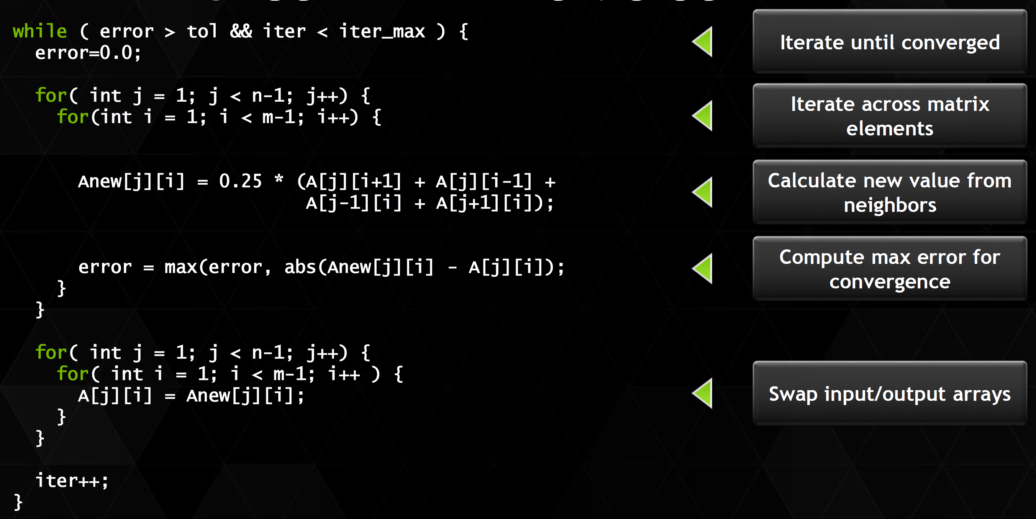
OpenACC
Jacobi Iteration Example
C code

Slide 15
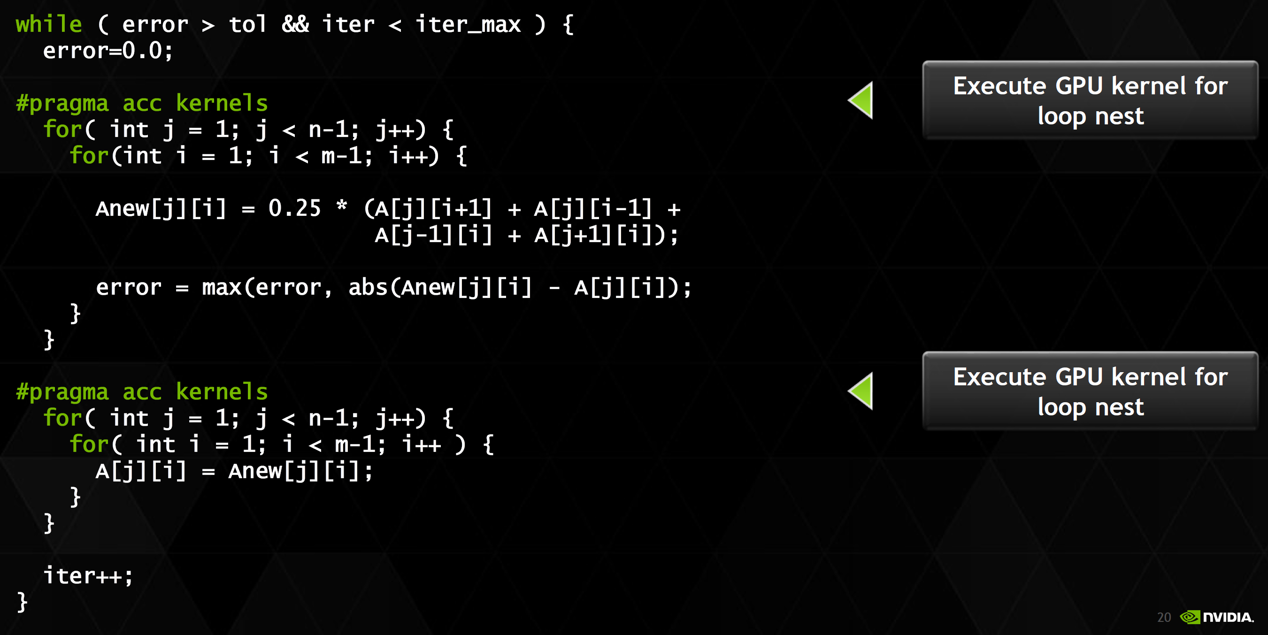
OpenACC
Jacobi Iteration Example
C code

Slide 16
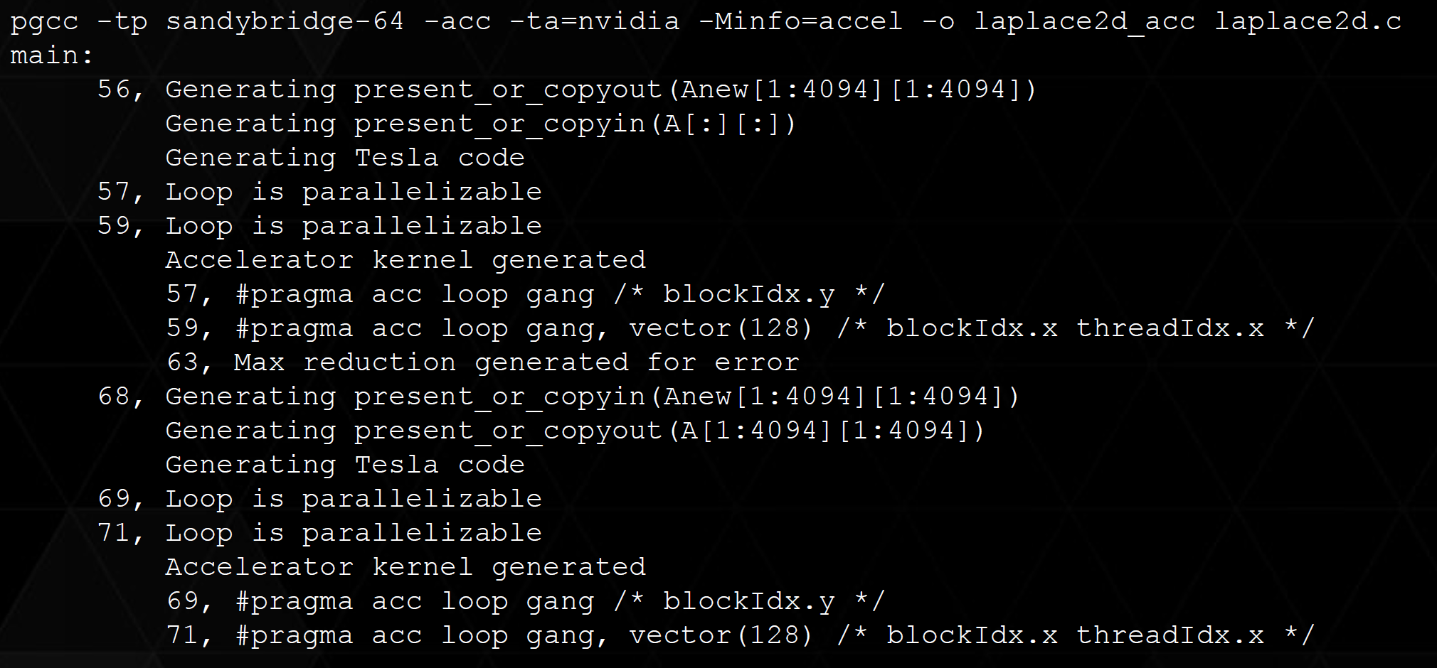
OpenACC
Jacobi Iteration Example
Compiling this example

Slide 17
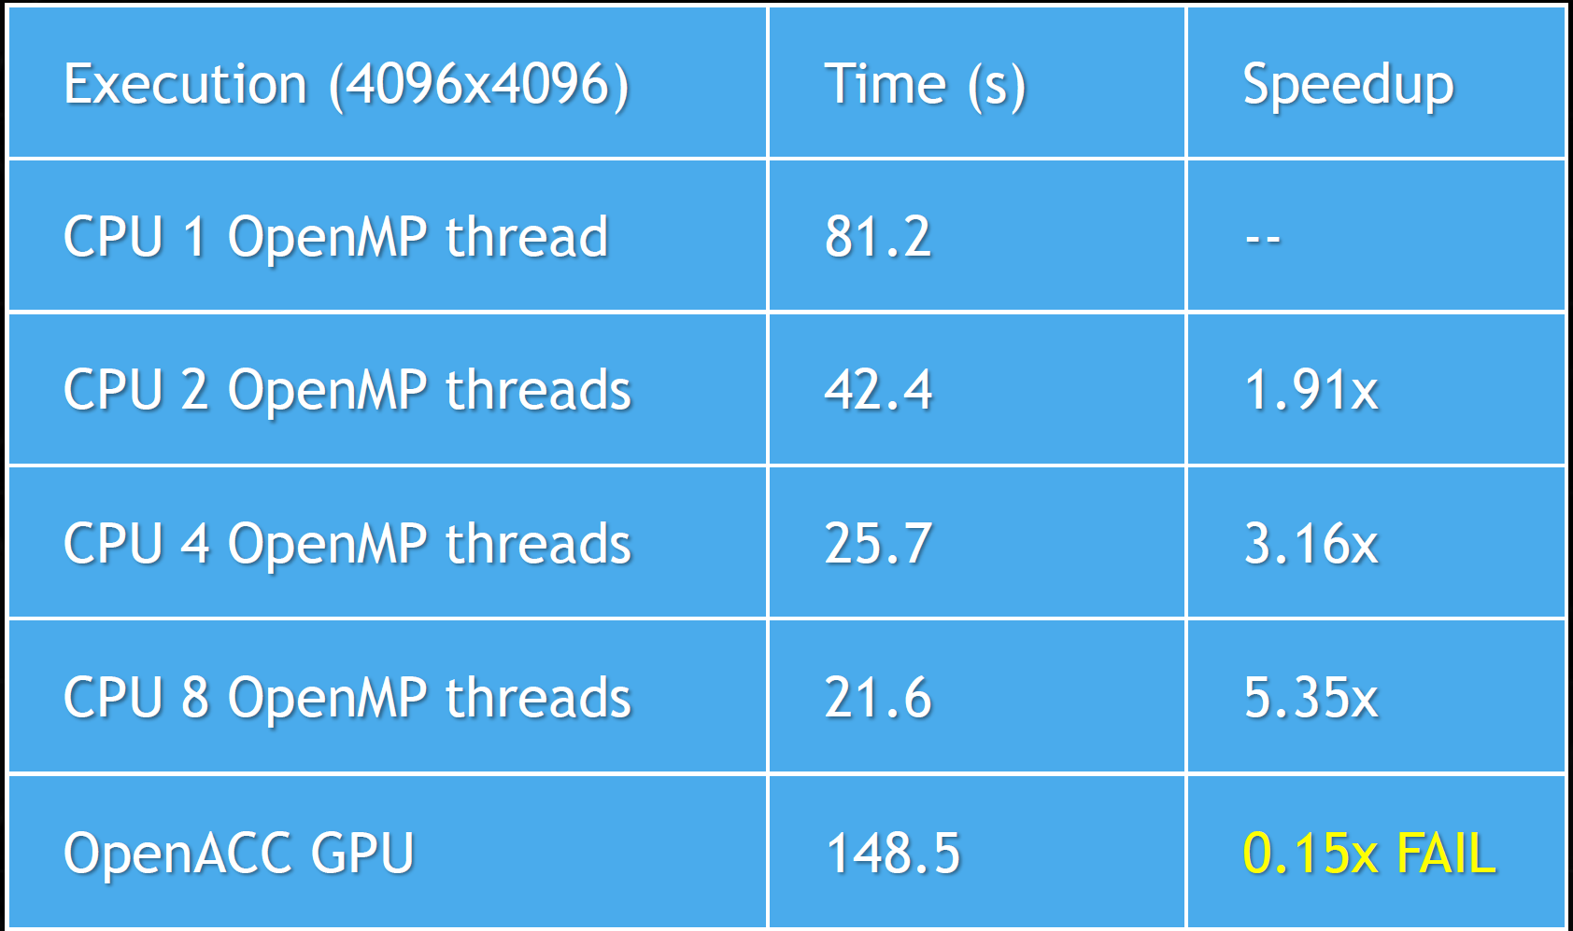
OpenACC
Results

Slide 18
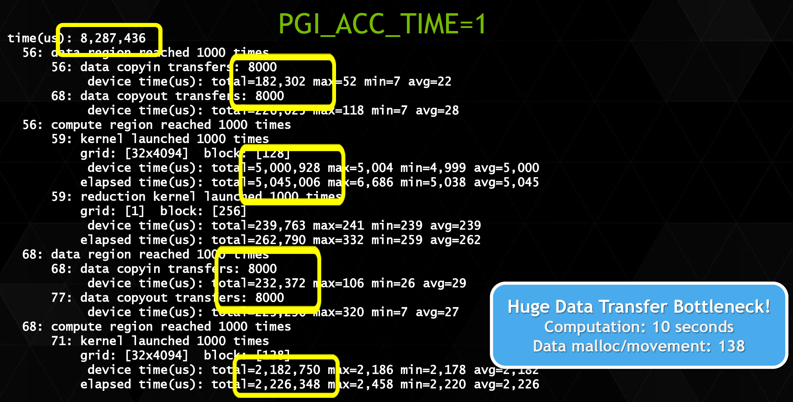
OpenACC
What happen here?

Slide 19
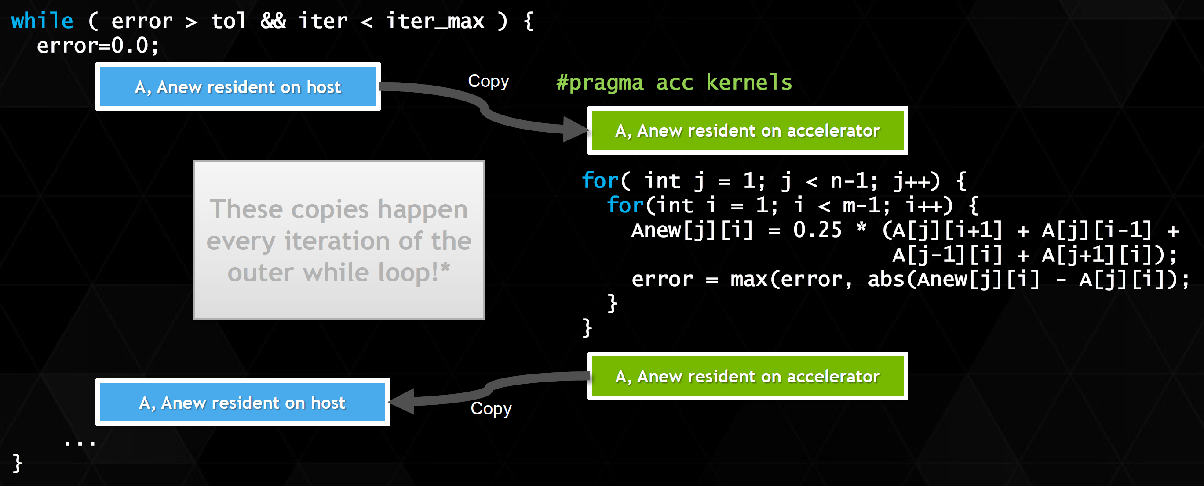
OpenACC
We are having excessive data transfers:

Slide 20
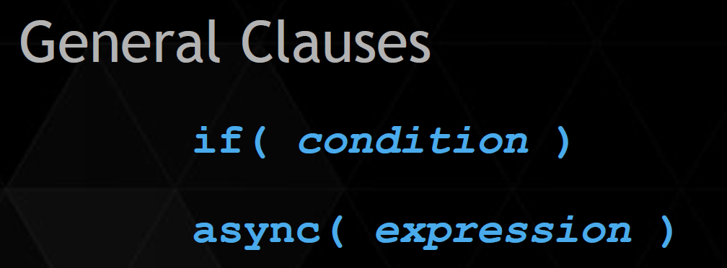
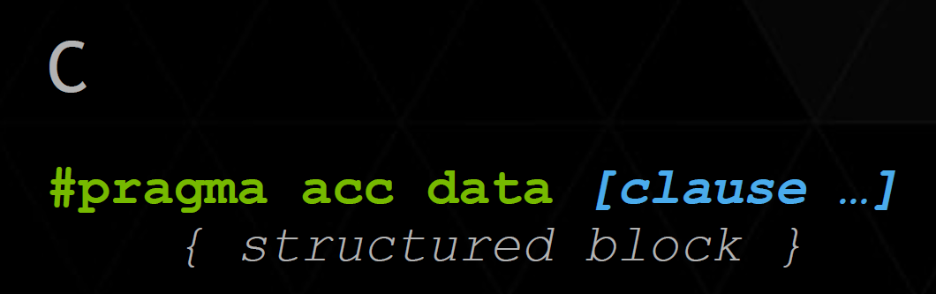
OpenACC
We need data constructs to handle the data appropriately
Manage data movement. Data regions may be nested.

Slide 21
OpenACC
Data Clause | Explanation
copy ( list ) | Allocates memory on GPU and copies data from host to GPU when entering region and copies data to the host when exiting region.
copyin ( list ) | Allocates memory on GPU and copies data from host to GPU when entering region.
copyout ( list ) | Allocates memory on GPU and copies data to the host when exiting region.
create ( list ) | Allocates memory on GPU but does not copy.
present ( list ) | Data is already present on GPU from another containing data region

Slide 22
OpenACC
This clauses are not simple to use
Compiler sometimes cannot determine size of arrays
Must specify explicitly using data clauses and array “shape”

Slide 23
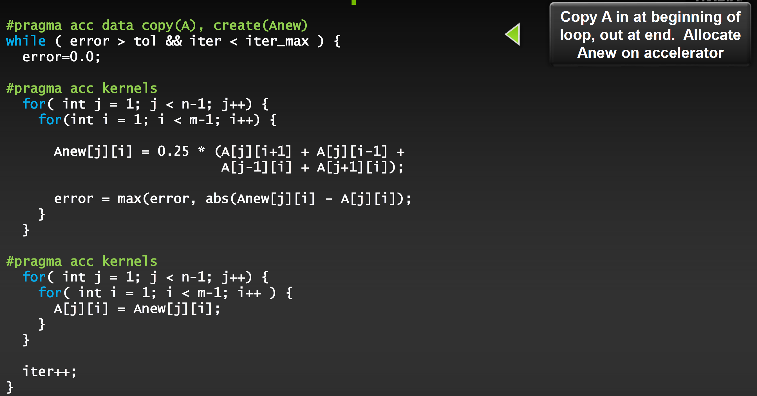
OpenACC

Slide 24
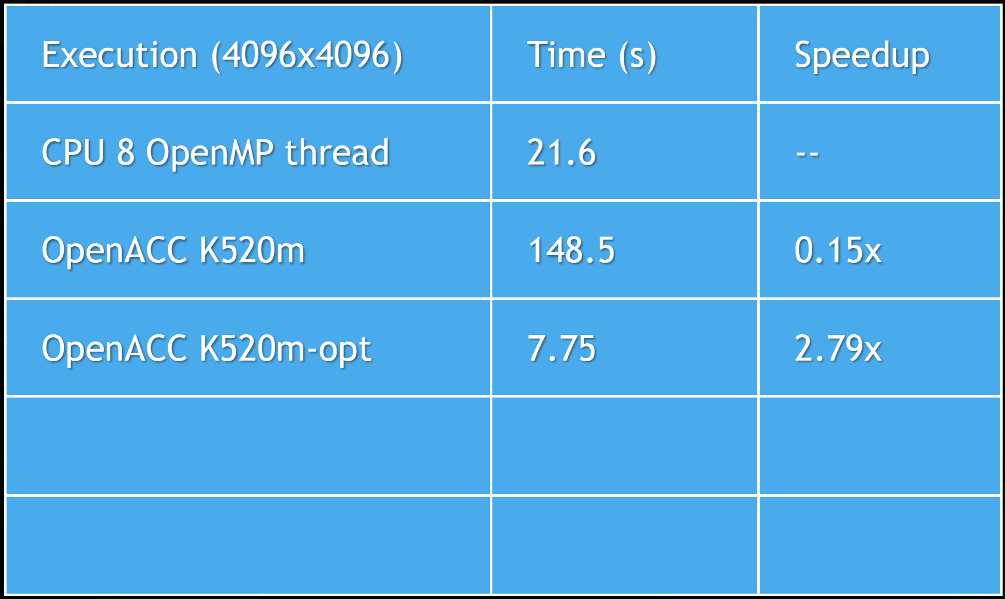
OpenACC

Slide 25
OpenACC
Other Speed Up options
OpenACC gives us more detailed control over parallelization
Via gang, worker, and vector clauses
By understanding more about OpenACC execution model and GPU hardware organization, we can get higher speedups on this code
By understanding bottlenecks in the code via profiling, we can reorganize the code for higher performance

Slide 26
OpenACC
Finding parallelism in your code
Nested for loops are best for parallelization
Large loop counts needed to offset GPU/memcpy overhead
Iterations of loops must be independent of each other
Compiler must be able to figure outsizes of data regions
Pointer arithmetic should be avoided if possible
Function calls within accelerated region must be inlineable.

Slide 27
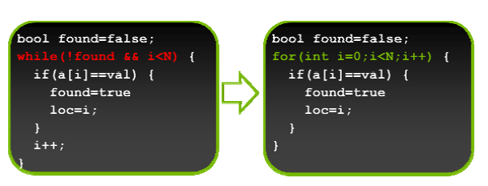
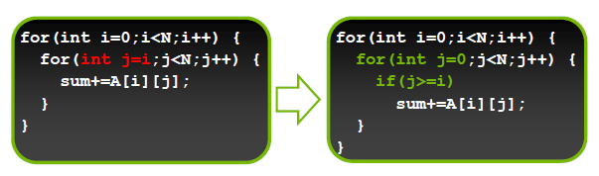
OpenACC
Tips and tricks
(PGI) Use time option to learn where time is being spent
Eliminate pointer arithmetic
Avoid Inline function class in directive regions
Use contiguous memory for multi-dimensional arrays (optimize data locality)
Use data regions to avoid excessive memory transfers
Write parallelizable loops
Write rectangular loops

Slide 28
Other Features
Not covered during previous sessions

Slide 29
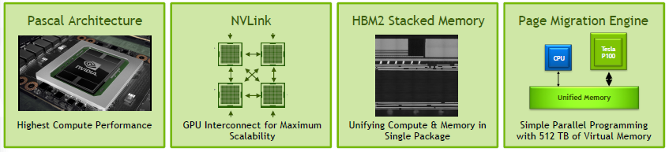
Features available on Pascal
More P100 Features: compute preemption, new instruction, larger L2 cache, more…

Slide 30
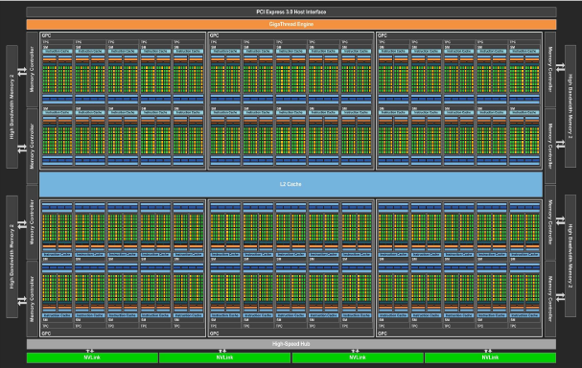
Tesla P100 GPU: GP100
56 SMs (next slide)
3584 CUDA cores
5.3 TF Double Precision
10.6 TF Single Precision
21.2 TF Half Precision
16 GB HBM
720 GB/s Bandwidth

Slide 31
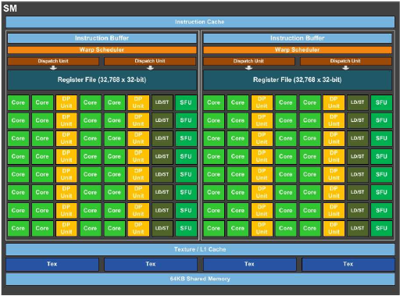
GP100 SM
64 CUDA Cores
256 KB Register File
64 KB Shared memory
2048 active threads
32 active blocks

Slide 32
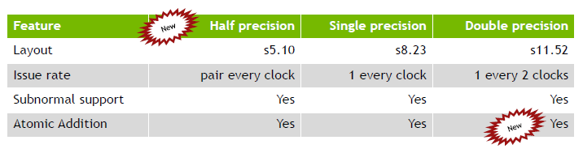
IEEE 754 Floating point on GP100
Notes:
Explain half precision sucks on GTX1080 because they removed the half precision units from the sms (left only 1 I think).

Slide 33
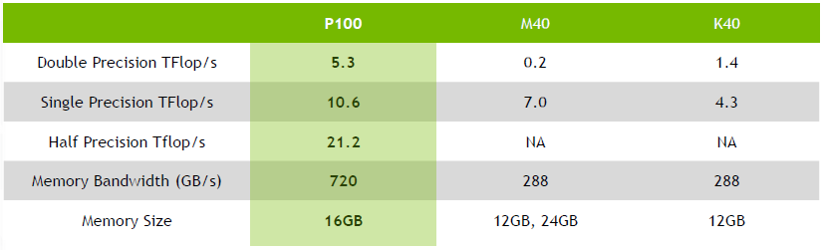
GPU Performance Comparison

Slide 34
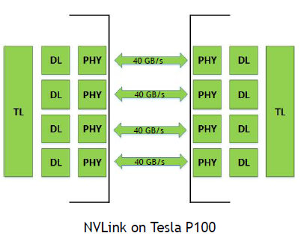
NVLINK
P100 supports 4 NVLinks
Up to 94% bandwidth efficiency
Supports read/writes/atomics to peer GPU
Supports read/write access to NVLink-enabled CPU
Links can be ganged for higher bandwidth

Slide 35
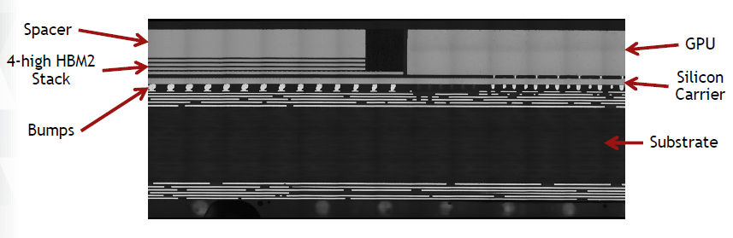
HBM2: 720 GB/SEC Bandwidth

Slide 36
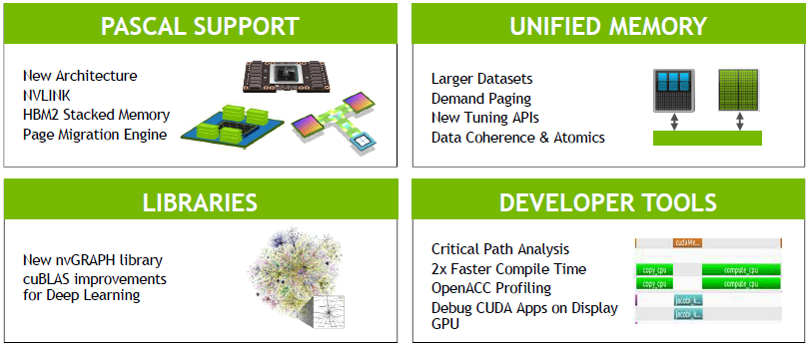
CUDA 8

Slide 37
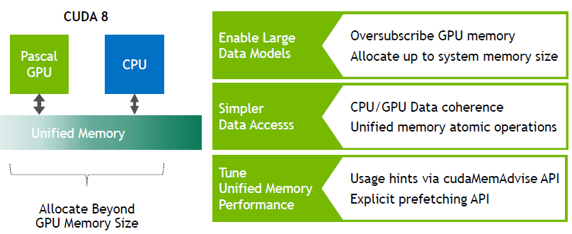
CUDA 8 Unified memory

Slide 38
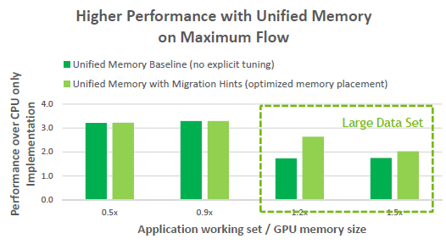
CUDA 8 Unified memory
On-Demand Paging
New use cases such as graph algorithms

Slide 39
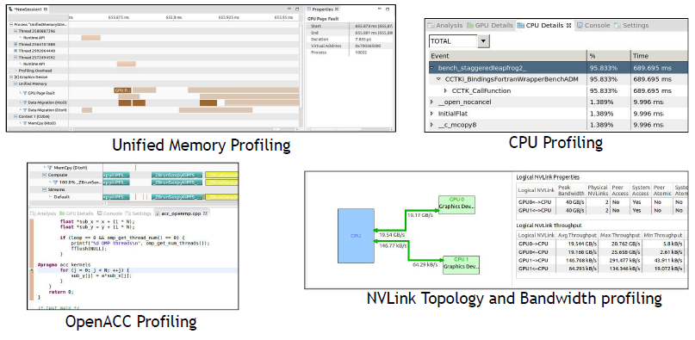
More CUDA 8 Profiler Features
Including
Dependency analysis
OpenACC profiling
Profile CPU Code with NVVP

Slide 40
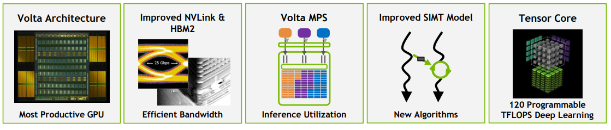
Features available on Volta

Slide 41
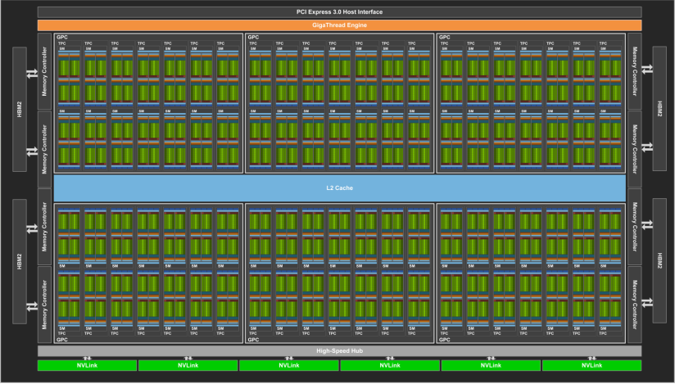
Tesla P100 GPU: GP100
80 SMs
5120 CUDA cores
640 Tensor Cores
16 GB HBM2
900 GB/s Bandwidth HBM2
300 GB/s NVLink

Slide 42
GV100 SM
64 FP32 units
32 FP64 units
64 INT32 units
8 Tensor Cores
256 KB Register File
128 KB L1/Shared memory
2048 active threads

Slide 43
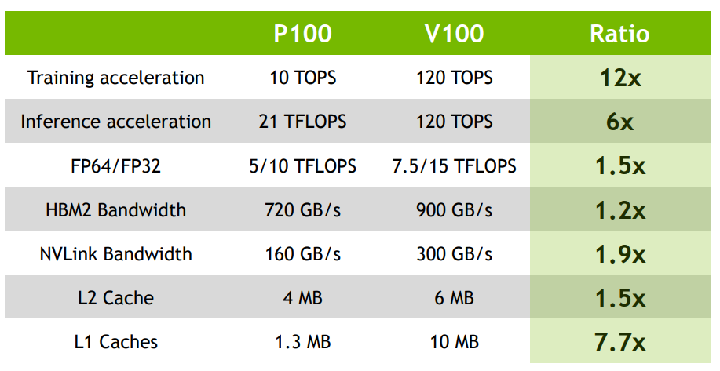
GPU Performance Comparison

Slide 44
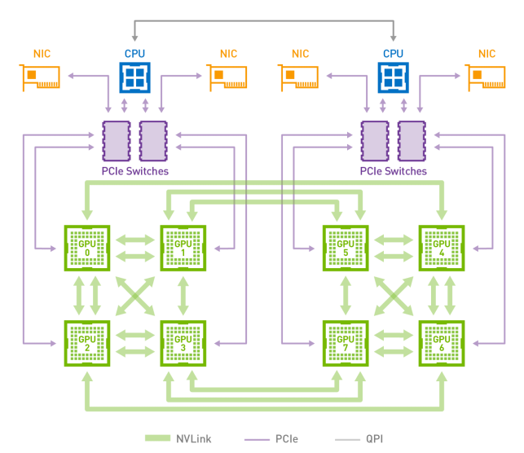
NVLINK
V100 supports 6 NVLinks
28% Faster signaling
300 GB/s

Slide 45
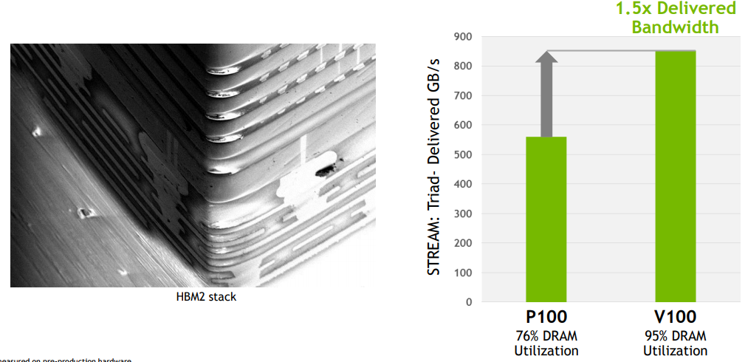
HBM2: 900 GB/s Bandwidth

Slide 46
Deep Learning
GPU’s are more and more being used for Deep learning and machine learning applications.
Take this opportunity that you already know how GPU’s work and delve into deep learning applications with GPU’s.
https://www.nvidia.com/en-us/deep-learning-ai/education/

Slide 47
Features available on Volta
Many more features I can’t cover today, including cooperative threads, tensor cores, etc.
Look into them in the following links:
http://on-demand.gputechconf.com/gtc/2017/presentation/s7798-luke-durant-inside-volta.pdf
https://devblogs.nvidia.com/parallelforall/cuda-9-features-revealed/

Slide 48
Throw-Down
Lets do this!

